Slide 1
DSE 6220
Big Data
Hadoop & Spark
Week 1

Slide 2
What is Big Data?
Building Blocks of Big Data
When we say big data we typically are referring to distributed systems
Any system with 2 or more ‘nodes’ acting together providing redundancy and compute
Examples: Hadoop, MongoDB, CouchDB, HBASE
Hardware
Distributed systems
Servers and network equipment working together
Software
Hadoop (data infra/data warehouse)
Spark (software for mining)
Data Management
Data governance, encryption, access, & compliance
End Users
Users engaging int ETLs or data mining related activities

Slide 3
Types of Big Data
Structured
Unstructured
Recall from 6210, data is structured if it has a defined schema or is tabular
Examples: CSV, relational database tables, etc.
Data types and columns can be defined
Recall from 6210, data is structured if the schema cannot be defined
Examples: JSON, XML, data coming from the internet, etc

Slide 4
Sources of Big Data
Social Networks
The original source of ‘big data’
Every action on SM platforms is tracked and stored in a data warehouse
Images, posts, comments etc
Media
Think YouTube, Netflix, etc
Storage of audio and video data
Data warehouses
Historically data was stored in relational data warehouses such as Oracle
Company emails, databases, accounting records, etc shifted to big data platforms
Sensors
IoT devices
Cellular network sensors (radio towers etc)

Slide 5
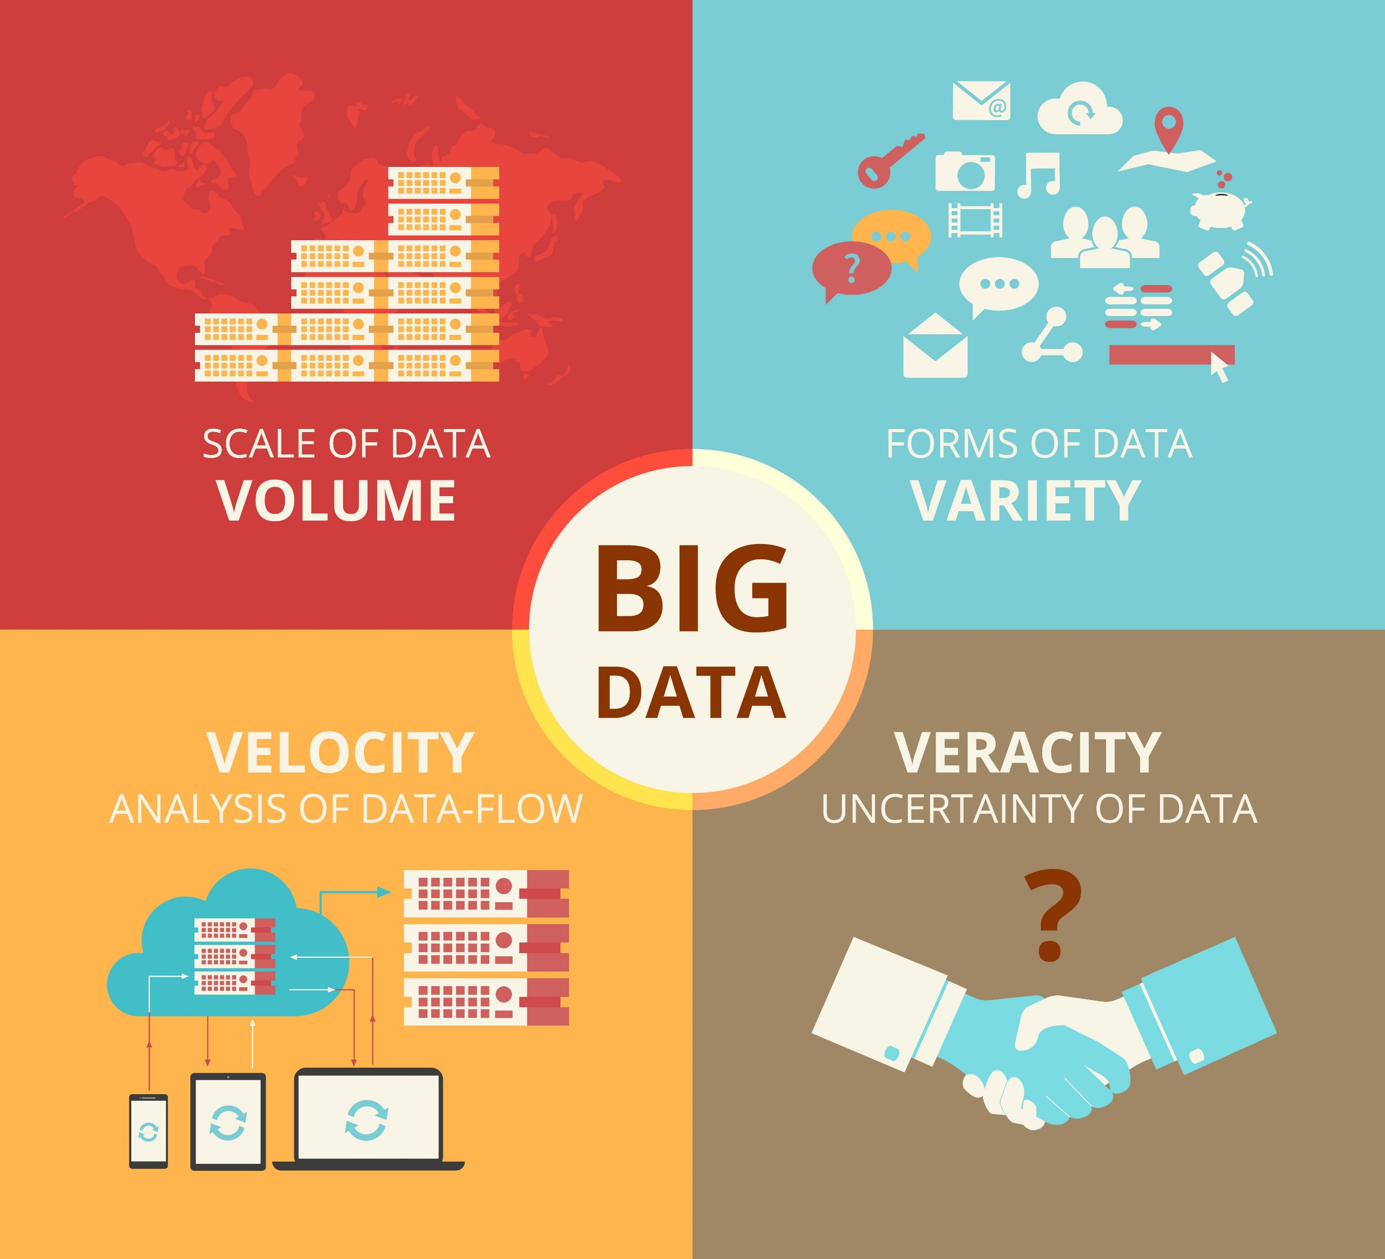
The 4 Vs of Big Data
Volume - The amount of data being stored often in terabytes or petabytes
Variety – The different types of data
Data lakes
Velocity – The speed at which data is being generated and collected
Veracity – Noise and inconsistencies in data

Slide 6
What is Big Data Mining?
Definition
Tools
Entire lifecycle of processing large-scale datasets from procurement to implementation of the respective tools to analyze them
ETL – Extract Transform and Load
Process of acquiring raw data and transforming it into usable tables or documents
Hadoop – A filesystem with tools that enables big data mining
NoSQL – Distributed document databases that store key-value pairs
Cloud tools such as Redshift and EMR clusters

Slide 7
Hadoop Ecosystem
A conglomeration of various tools and projects all under the Apache Software Foundation
Built on a distributed filesystem called HDFS
MapReduce - Originally written in compiled Java each Hadoop job consists of a mapper and reducer
Tasks are ‘mapped’ to different nodes of the cluster
Filtering & sorting
Tasks are ‘reduced’ to the master
Summary statistics like counts etc are calculated across all nodes and provided to the master
YARN – Framework for scheduling, resource management, and job monitoring
All jobs on Hadoop are monitored in YARN
Tools include
Hive
Data is accessed on each node’s disk and not stored in memory
Spark
Leverages DAGs to optimize operations into a smaller set of operations
Distributed in nature
RDDs store data in memory

